Slide 1
Ovarian cancer
Prof. Nisha Singh
MD (AIIMS), FICOG
Dept. of Obstetrics & Gynecology
King George Medical University
Lucknow

Slide 2
INTRODUCTION
Fourth most common cause of death in women
30% of genital malignancies in the developed countries
5% of all gynecological cancers in India.
Lifetime risk of having ovarian cancer 1.7%
Majority (70%) of cases are diagnosed in advanced stage .

Slide 3
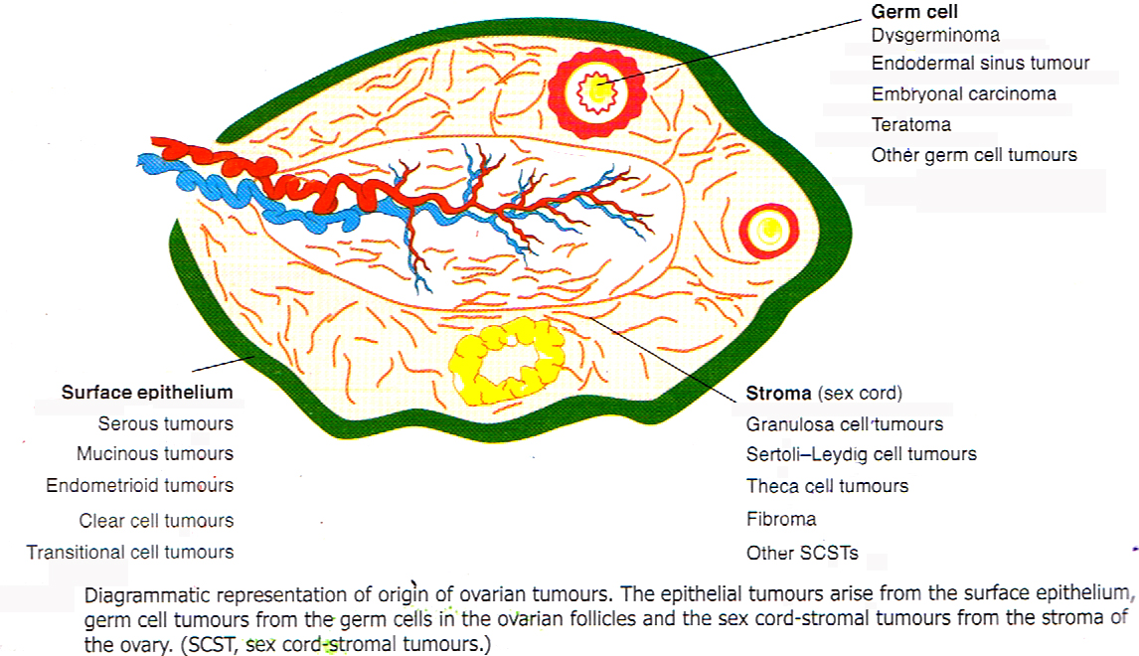
histological classification of ovarian tumors

Slide 4
EPITHELIAL CANCER
Most common ovarian cancer- 90% .
80% are primary in ovary
20% -metastatic from breast ,GIT , and colon
Mean age at diagnosis - 60 years.
Effect of menopausal status In menopausal women- 30% of ovarian neoplasm are malignant In premenopausal women- 7% are malignant.

Slide 5
ETIOLOGY
Various theories
Etiology not well known
Hereditary or familial ovarian cancer
BRCA 1&2 mutations
Ras oncogenes,
p53 mutations

Slide 6
RISK Modifiers
Risk factors
Protective factors
Nulliparity
Infertility
Early menarche
Late menopause
Endometriosis
Family history
Talc use
Prolonged use of ovulation inducing drugs
HRT
Oral contraceptive
Pregnancy
Breast feeding
Tubal –ligation
Hysterectomy
Prophylactic salpingo-oophorectomy.

Slide 7
WHO CLASSIFICATION OF EPITHELIAL TUMOURS (2003)
Serous adenocarcinoma
Mucinous tumours
Adenocarcinoma
Pseudamyxoma peritonei
Endometroid tumours
Adenocarcinoma
Mixed mullerian tumour
Clear cell adenocarcinoma
Transitional cell tumours
Brenner tumour
Transitional cell carcinoma
Rare tumours
Mixed carcinoma
Squamous cell carcinoma
Undifferentiated
Small cell carcinoma

Slide 8
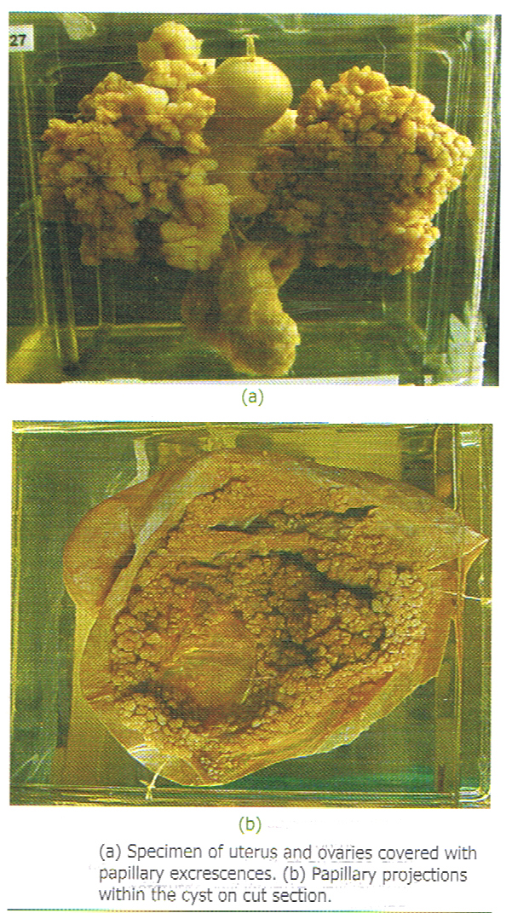
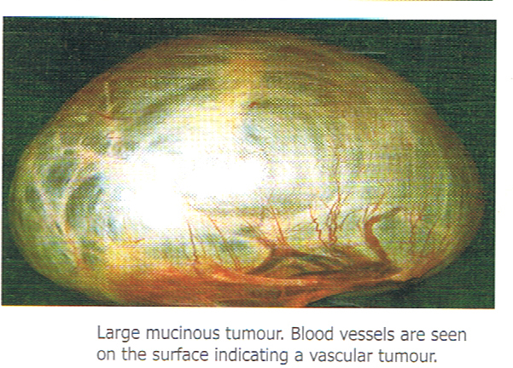
PATHOLOGY

Slide 9
Histological features and frequency of Epithelial tumors
 | Cellular type | Other features | Frequency
Serous | Fallopian tube | Psammoma bodies | 80%
Mucinous | Endocervical | Mucin-secreting cells | 10%
Endometroid | Endometrial | Majority well differentiated | 10%
Clear cell | Mullerian | Clear and hobnail cell | <1 %
Transitional cell | Transitional cell | Dense, abundant fibrous stroma | <1%

Slide 10
Distinct clinical behavior
Irrespective of histology
Low grade tumors- usually serous or mucinous, asstd pseudomyxoma peritonei, responsive to CT, B raf and K raf mutations, longer progression free survival
High grade (Invasive cancer)- invasive(G2&3), p53 mutations, Poor prognosis
Borderline tumors —15%, more in premenopausal, only 20% of these are metastatic

Slide 11
Ovarian cancer screening
Methods
Annual pelvic examination
Pelvic ultrasound
CA 125
Serum proteomic screening.
Multimodal screening
None is reliable and cost effective in general population
Indicated in familial ovarian cancers only BRCA1 & 2 gene mutations- if positive (82% risk) screen from 35yrs or prophylactic OCP or RR salpingooophorectomy

Slide 12
CLINICAL FEATURES
Symptoms
Sign
Asymptomatic
Anorexia, wt loss
Abdominal –pain/ distension/bloating
Irregular mass
Dyspnoea
Nausea/constipation
Urinary frequency
Ascites
Lower abdominal/ pelvic mass
Omental cake
Nodules in pouch of douglas
Rectal examination

Slide 13
diagnostic criteria of ovarian cancer
Ultrasonography
Ovarian volume>10cm3
Solid/complex(solid and cystic)
Multiloculated
Thickness of cyst wall>3mm
Septal thickness>2mm
Bilaterality
Papillary excrescences
Doppler flow studies
Increase in vascularity
RI<0.04
PI<1
CA-125
HE 4, S. Inhibin

Slide 14
Other diagnostic methods
CT scan -Detects disease 1.5-2 cm
MRI - Detects disease >1cm
PET Scan- for distant disease
Confirmed by Cytology or tissue diagnosis
Paracentesis
FNAC
Surgical specimen

Slide 15
ASSESSING RISK OF MALIGNANCY IN OVARIAN TUMOUR
Morphological index
Risk of malignancy index
Serum biomarker levels
Colour flow doppler
Serum proteomics.

Slide 16
RMI (risk of malignancy index)
RCOG guidelines
RMI=U X M X CA125
USG score(0, 1,3) Multilocular cyst, solid areas, metastasis, ascites, bilateral lesions
M score (premenop=1, postmenop=3)
RMI <25-low risk, 25-250-mod risk, >250-high risk

Slide 17
FIGO STAGING OF OVARIAN CANCER 1st Jan 2014
Stage I | Growth limited to the ovaries
IA | Growth limited to one ovary, No tumor on surface, negative washings
IB | Growth in both ovaries else same as IA,
IC | Tumor limited to one or both ovaries
IC1 | Surgical spill
IC2 | Tumor rupture before surgery or tumor on surface
IC3 | Malignant cells in ascites or peritoneal washings

Slide 18
Stage II Growth involving one or both ovaries with pelvic extension
IIA | Extension and/or metastases to the uterus and/ or fallopian tubes
IIB | Extension to other pelvic tissues- bladder , rectum, sigmoid colon

Slide 19
Stage III A | Positive retroperitoneal lymph nodes and/or microscopic metastasis beyond pelvis
IIIA1 | i--- metastasis<10mm ii—metastasis> 10mm
IIIA2 | Microscopic extrapelvic peritoneal involvement with or without RP LN
IIIB | Macroscopic extrapelvic peritoneal metastasis, none exceeding 2 cm in diameter with or without RPLN Includes capsule of liver or spleen
IIIC | Macroscopic, extrapelvic, peritoneal implant >2 cm with or without positive retroperitoneal nodes.
Stage IV A | Pleural effusion with positive cytology .
IV B | Hepatic and/or splenic parenchymal metastasis Metastasis to extra abdominal organs (inguinal nodes)

Slide 20
MANAGEMENT
Early ovarian cancer (Stage I and II)
Surgical staging and debulking
Ascitic fluid cytology or peritoneal washings
Total abdominal hysterectomy
Bilateral salpingo-oophorectomy
Omentectomy
Pelvic and para-aortic lymphadenectomy
Multiple peritoneal biopsies

Slide 21
Adjuvant therapy
Early stage disease
Stage IA G1/2 (low risk) No adjuvant therapy
Stage IA G3, IB-II (high risk) 3 cycles of chemotherapy
Advanced stage disease
Stage III & IV 3-6 cycles of chemotherapy
Carboplatin and Paclitaxel- Standard combination

Slide 22
Management of advanced-stage epithelial ovarian cancer
Staging laparotomy and primary cytoreductive surgery followed by
Postoperative adjuvant chemotherapy.
Best results with Nil residual disease
Debulk to microscopic level
For inoperable tumors or high surgical risk cases
Neoadjuvant Chemotherapy (NACT) followed by surgery and post operative chemotherapy .

Slide 23
Subsequent management
Complete response Follow-up
Partial response Continue same chemotherapy
or switch to second line
chemotherapy
Stable disease switch to second line
chemotherapy
Progression of d/s switch to second line
chemotherapy

Slide 24
Second line chemotherapy and other modalities
Docetaxel
Topotecan
Doxorubcin
Gemcitabine
Etoposide
Ifosfamide
Tamoxifen
Immunotherapy
Hormone therapy
Gene therapy
Radiation therapy
High dose chemotherapy and autologus bone marrow transplantation

Slide 25
Follow up
3 monthly for 2yrs
4-6monthly for 3-5 yrs
Annually after 5 yrs
Methods– clinical, CA 125 (optional)
CA 125 and CT for suspected recurrence

Slide 26
Q1
Which is the most common type of ovarian cancer?
Epithelial
Germ cell
Sex cord stromal
Undifferentiated

Slide 27
Q2 All are risk factors for ovarian cancer EXCEPT
Nulliparity
Early menarche
Endometriosis
Tubal ligation

Slide 28
Q3
Screening for ovarian cancer is recommended for
Women above 40 years
Women above 60 years
All women
Women at high risk for familial ovarian cancer

Slide 29
Q4
FIGO stage III of ovarian cancer includes
Tumor limited to one ovary
Tumor involving both ovaries
Tumor extending to pelvic organs
Tumor extending to abdominal cavity

Slide 30
Q5 Ovarian cancer is primarily managed by
Chemotherapy
Radiotherapy
Immunotherapy
Staging Laparotomy

Slide 31
What is the position of prevalence of ovarian cancer among genital cancers
1
2
3
4

Slide 32
Which other cancer is Associated with hereditory ovarian cancer
GB
Lung
Breast
cervix

Slide 33
Borderline ovarian tumors are also known as
Tumors of low malignant potential
Tumors of high malignant potential
Hereditory ovarian tumors
Seccondary ovarian tumors

Slide 34
Spread to RP LN is seen in
Stage1&2
Stage 2&3
Stage3&4
Stage4 only

Slide 35
5yr survival rate of StageI ovarian CA is
30%
50%
70%
90%

